Slide 1
CS Traffic Flow
No use of elevator except disabled or heavy equipment
One way traffic
Enter through the door from the Engineering Key side (East)
Up to 2nd floor or 3rd floor
Walk from east to west
Exit from the door to the dean's office area
To walk from 2nd floor to 3rd floor
Walk down to ground floor
Exit the building
Enter the building from Engineering Key
Walk up to 3rd floor
To walk from 3rd floor to 2nd floor – exit the building and enter from East up to 2nd floor

Slide 2
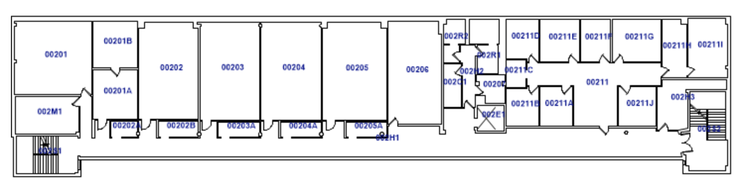
2nd Floor Engineering Building
Sanitization Station
Inaccessible Area
ENTER
UP
EXIT
Elevator
DOWN

Slide 3
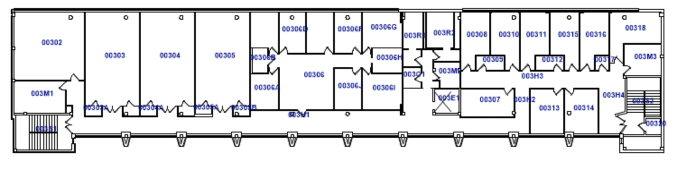
3rd Floor Engineering Building
Sanitization Station
Inaccessible Area
UP
DOWN

Slide 4
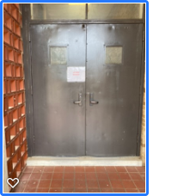
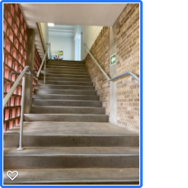
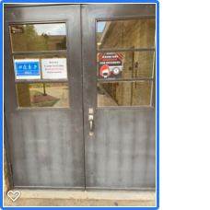
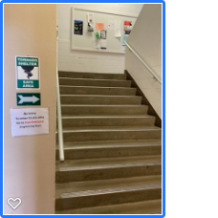
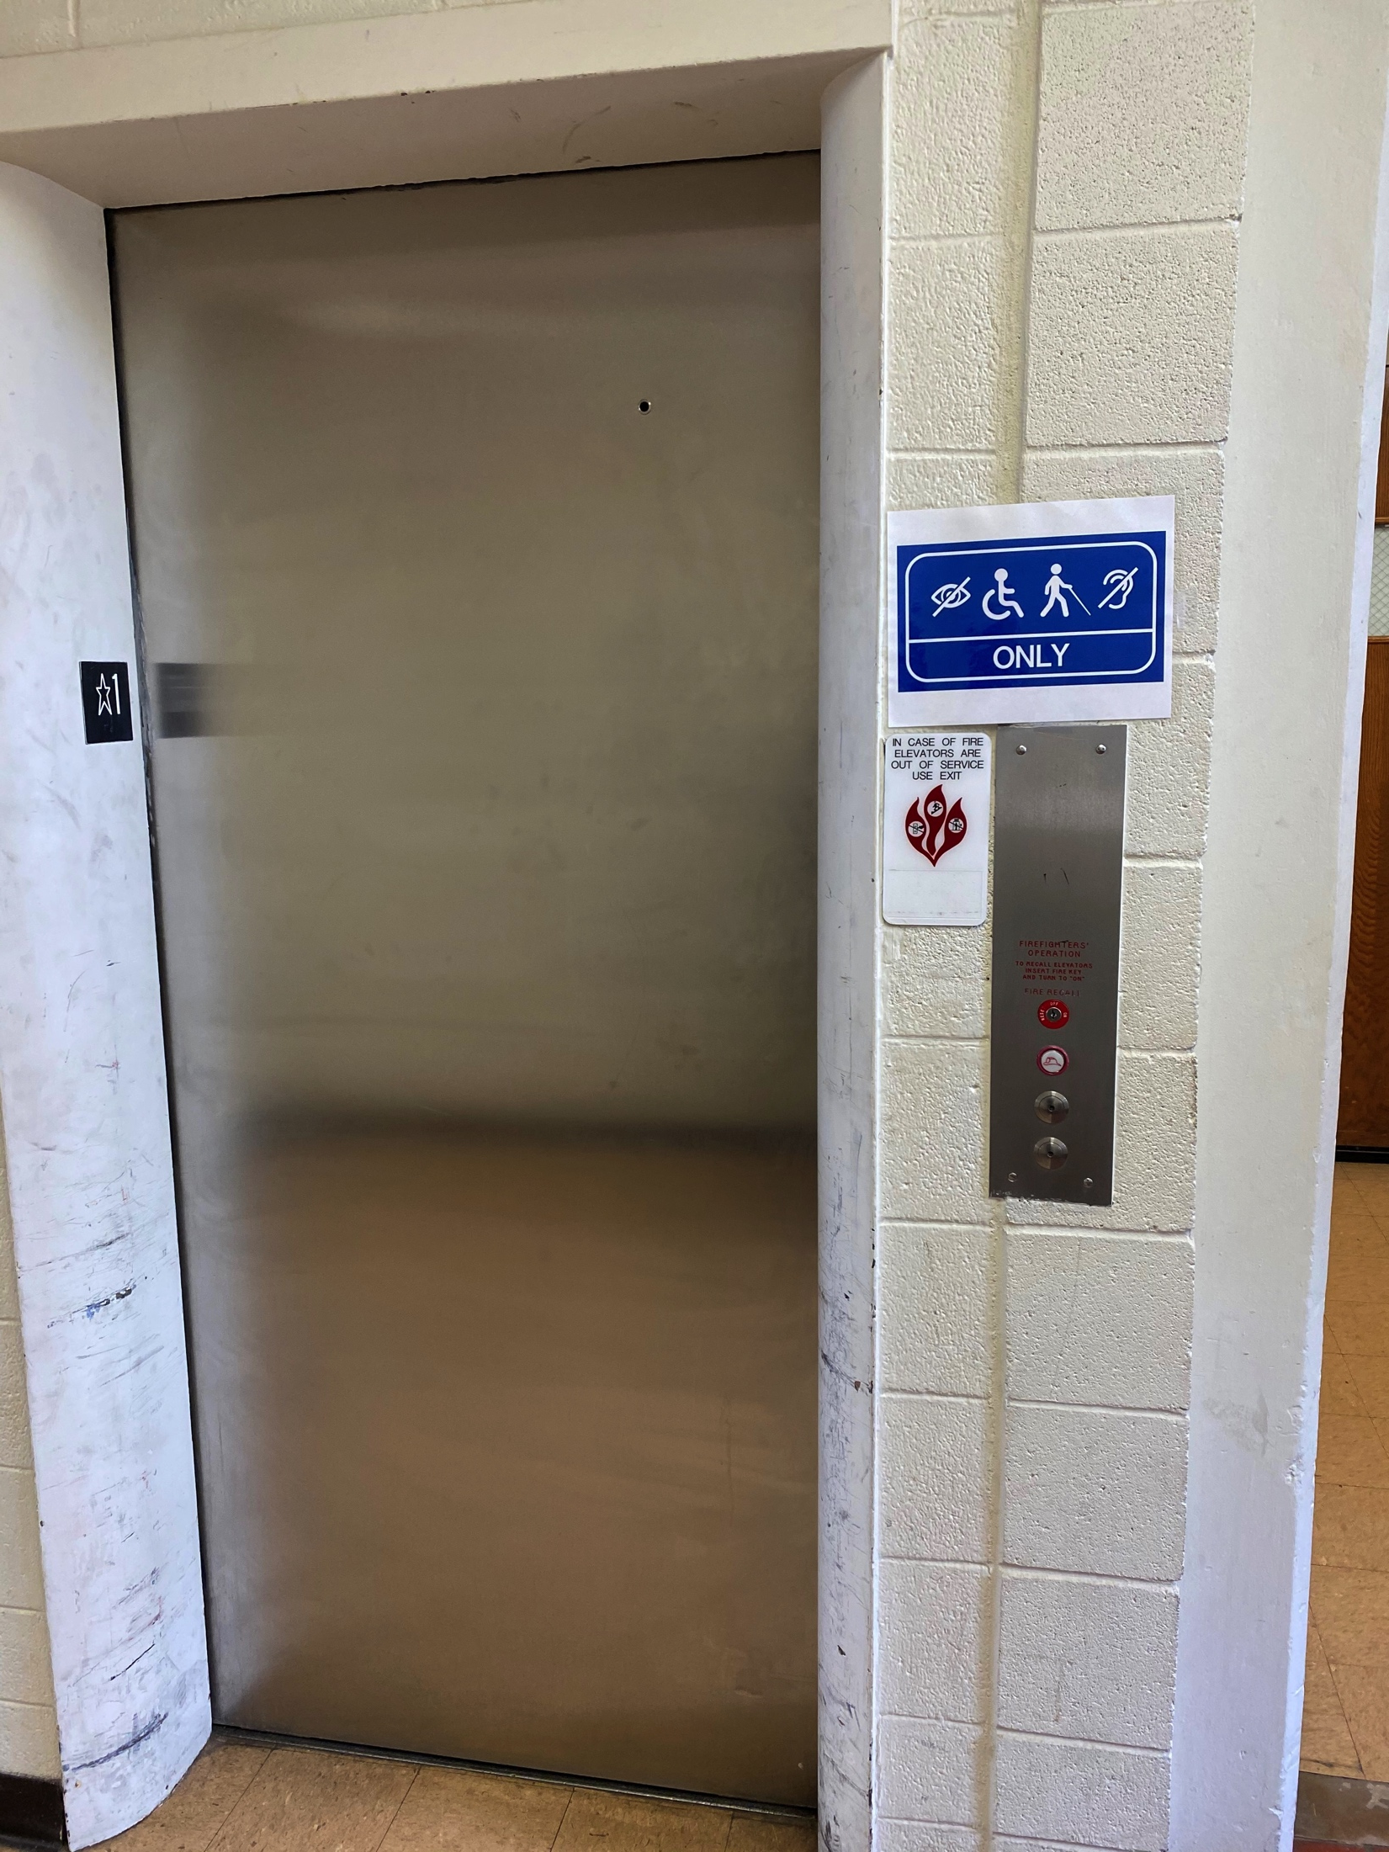
Ingress from Ground Floor
✖
✖
✖
✔
✔

Slide 5
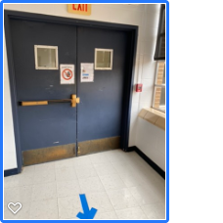
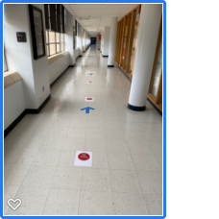
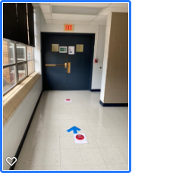
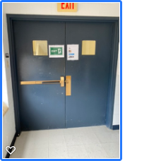
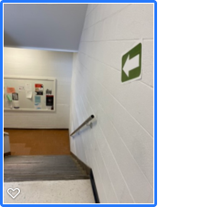
Egress from 2nd Floor
✔
✔
✔
✖

Slide 6
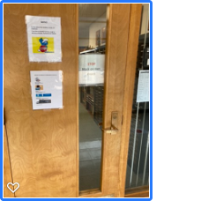
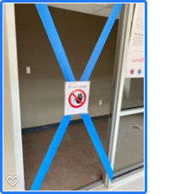
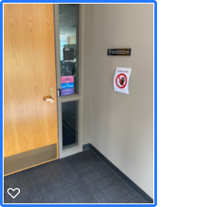
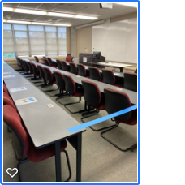
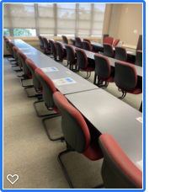
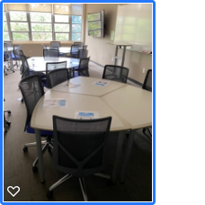
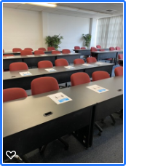
2nd Floor
Lock 211, 206, 203

Slide 7
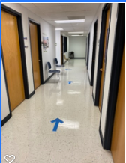
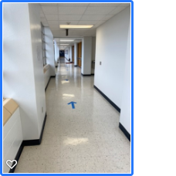
3rd Floor
Lock 306

